Slide 1

Project 3
Evan Sadasivan, Avinash Patel and Christine Nashashibi

Slide 2
Motivation & Summary
The aim of this project is to give investors a holistic view of the performance and potential trajectory of six different crypto currencies. We designed a streamlit app that provides clear insights and easily comprehensible data about both the close price of the currency and the sentiments expressed in news articles about the currency. The app is user friendly and provides timeline graphs as well as dataframes with the original data should users want to drill down further.

Slide 3
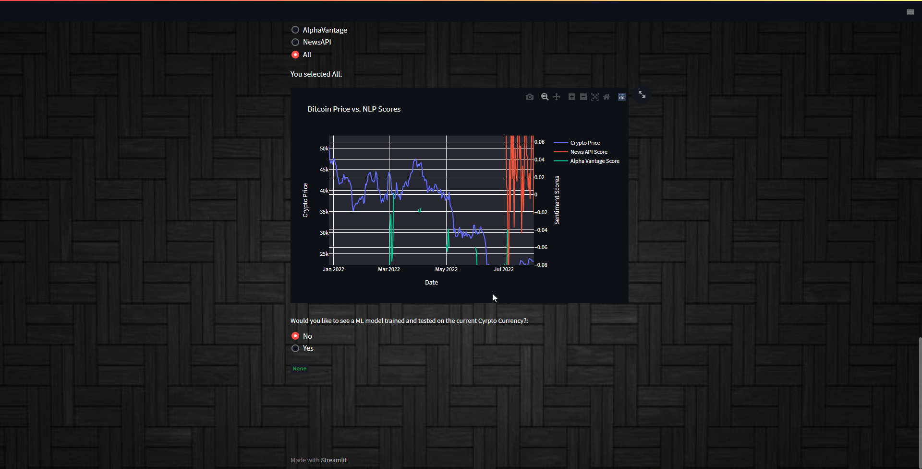

Slide 4
Cryptos
Bitcoin
Ethereum
Luna
Binance
Cardano
Solana
Notes:
Extra

Slide 5
Data Cleanup
Alpha Vantage Cryptocurrencies API
Alpha Vantage News and Intelligence API
News API
Articles were collected for sentiment analysis using APIs and compiled into dataframes
Notes:
Describe the exploration and cleanup process.
Discuss any problems that arose with preparing the data or training the model that you didn't anticipate.
Discuss the overall training process and highlight anything of interest with the training process: Cloud resources used, training time required, issues with training.

Slide 6
Alpha Vantage APIs
Historical price data for all cryptos from 08-21-2020.
Sentiment Data:
Limited number of calls.
Historical data to 03-01-2022.
[-1.0, 1.0] scale score

Slide 7
News API
Limited number of calls.
Historical data only goes back about 31 days.
Paywall for further historical data.
Headline sentiment analysis.
Up to 10 relevant headlines per day.

Slide 8
Textblob Library
Sentiment analysis done using textblob.
library for processing textual data.
Built on NLTK and Pattern.
The sentiment polarity score is a float within the range [-1.0, 1.0].

Slide 9
Machine Learning
Features:
Open price
High
Low
Volume
Market cap
Forecast:
Closing prices
Regression
Analysis

Slide 10
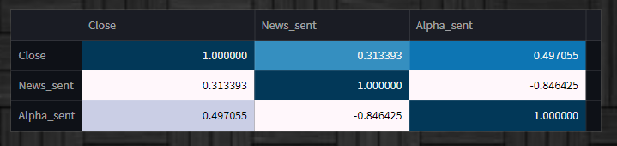
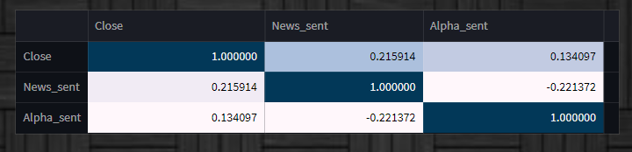
Correlation Findings
Luna
Solana
Notes:
Luna -
Bitcoin -
Ethereum -
Cardano -
Solana -
Binance -

Slide 11
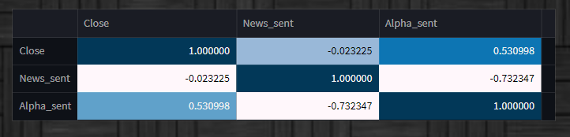
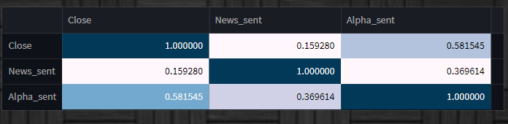
Correlation Findings
Bitcoin
Ethereum
Notes:
Luna -
Bitcoin -
Ethereum -
Cardano -
Solana -
Binance -

Slide 12
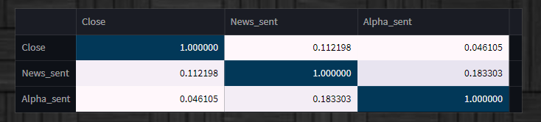
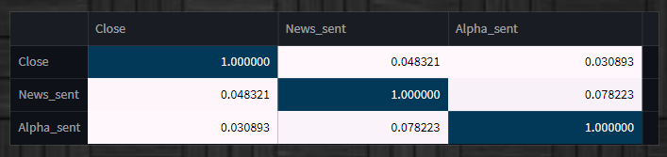
Correlation Findings
Binance
Cardano
Notes:
Luna -
Bitcoin -
Ethereum -
Cardano -
Solana -
Binance -

Slide 13

Questions
Open-floor Q&A with the audience.

